Slide 1

How do Organisms
Reproduce?
The process of reproduction (DNA coping)

Slide 2

In the last module we arrive at a thought whether Do organisms create exact copies of themselves???

Slide 3

Let us find out an answer to this in this module

Slide 4
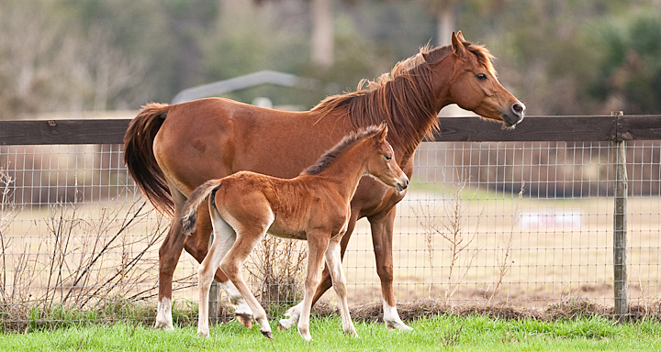
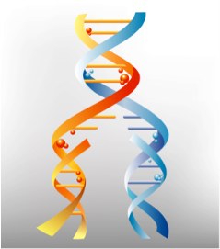
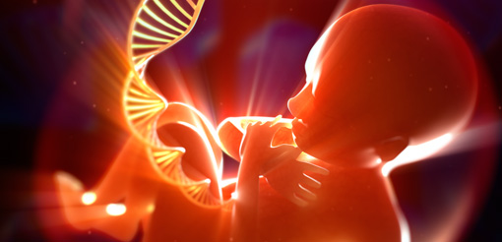
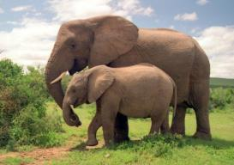
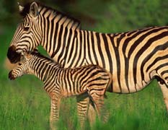
Reproduction
Organisms create new individuals which look very much like themselves.
Organisms look similar – body designs are similar.
Blue prints have to be similar.
Reproduction – making copies of the blue print.

Slide 5

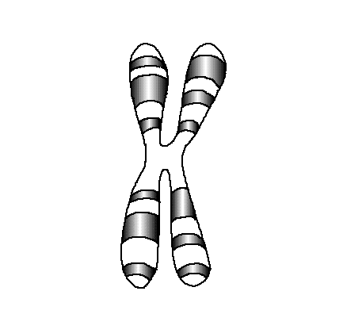

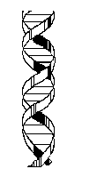
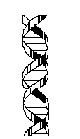

Chemical Reactions
DNA Copies
Variations
Chromosome
Nucleus
DNA
Reproducing cell
Identical
Similar

Slide 6
Thank You

